Slide 1
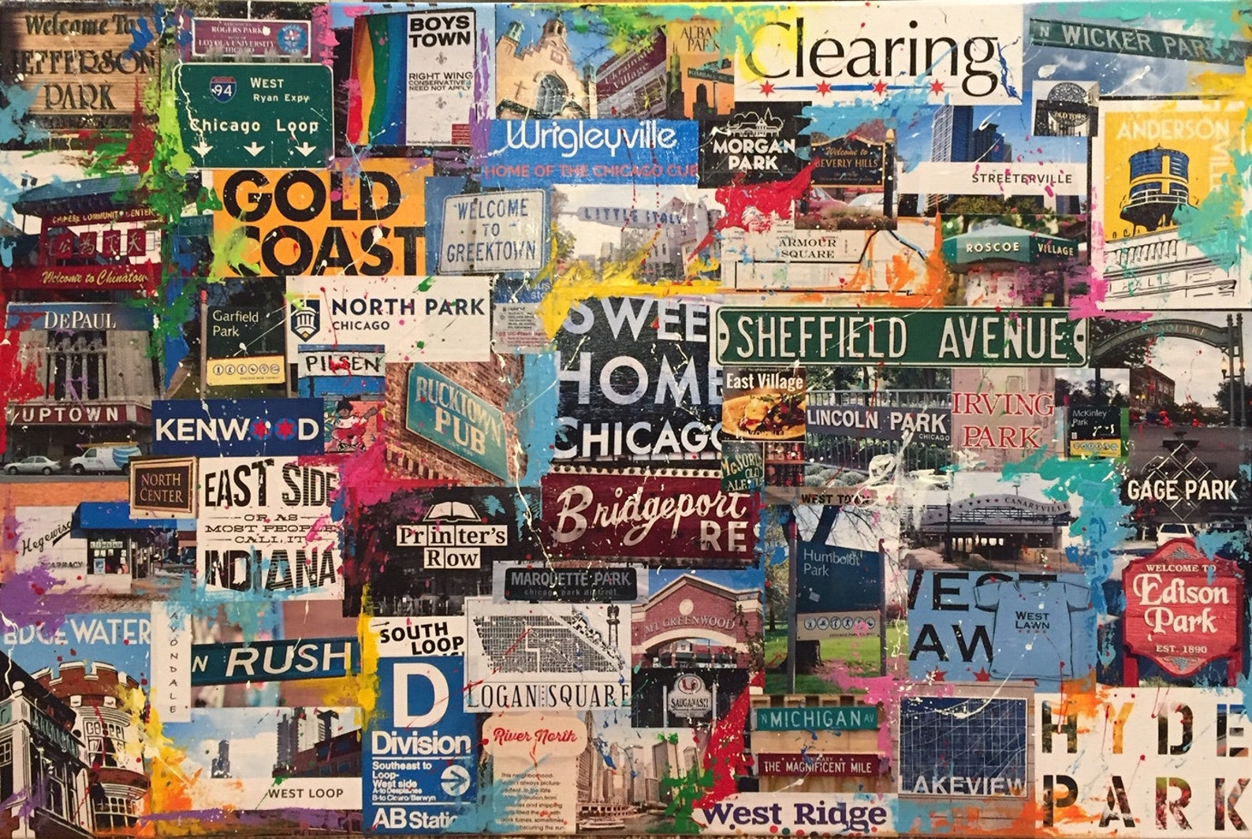
Illinois Population Trend – Analysis
Surendiran Rangaraj - NLP Final project

Slide 2

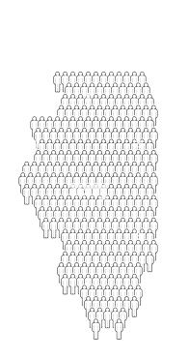
Executive Summary
Illinois lost over 850,000 residents to other states during the past decade, with the largest population decline of all states for six consecutive years.
With over 200,000 news articles about Illinois and Chicago from Jan 2018 till Nov 2021, analysis was performed to identify the sentiment over years and the major reasons people and organization wanted to leave or stay in the Chicago City and Illinois State.
As per excerpts from one of the news article , decline in immigration, increasing crime, decreasing economic opportunities, heavy taxes and pandemic are the biggest reasons why the state continues to lose population and our analysis showed similar results with State tax, Crime, Pandemic and weather being major reasons for the negative sentiment about the city and people moving out.
Research showed Schools, Entertainment/Leisure activities and diversity are the reason for people to stay in the state. Analysis is concluded with recommendation for the state to take action to reverse the trend.

Slide 3
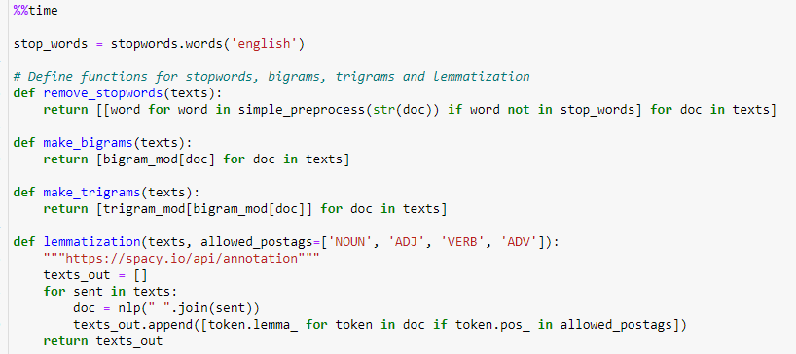
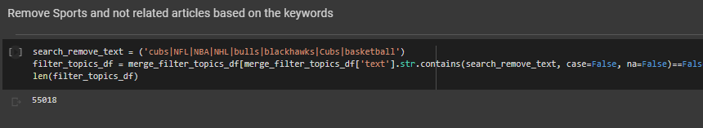
Text Article – Clean Up and Filtering Steps
Text PreProcessing functions
Cleaned text removing stop words, special characters, applied lemmatization
Performed Tokenization by words, bigram and trigram
Filtered articles related to Sports
Applied Rake algorithm for keyboard extraction
Created term dictionary on the lemmatized data for training LDA topic modeling
Filter Sports related articles based on keywords

Slide 4
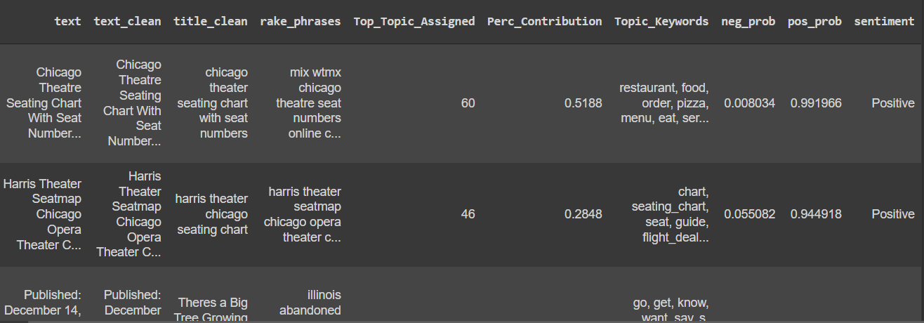
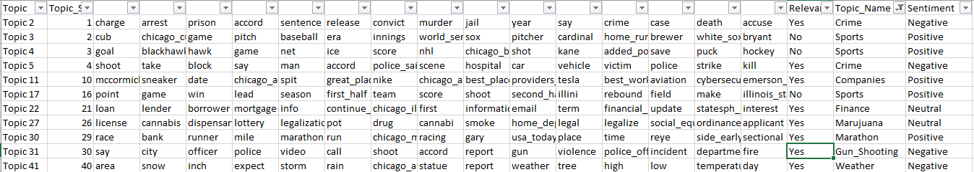
Topic Modeling
Used Genism LDA model for Hyperparameter Tuning and selected number of topics as 100
Manually reviewed each topic keywords , identify relevant topics, manually labelled the topic name and overall sentiment.
Appended the topic number, keywords to each of the 200k articles for analysis
Filtered the 65000 relevant articles based on the manually labelled topics
Performed further article filtering based on the keywords like NFL , NBA, basketball etc. and added articles with keywords population, tax, exodus etc.
Topics assignment, keywords(above)
Manually review of topics for relevance

Slide 5
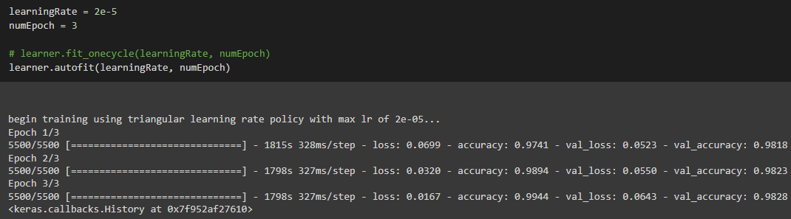
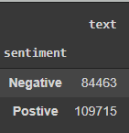
Sentiment analysis
For Sentiment Analysis , applied 2 approaches for training
Used Yelp reviews as Training Dataset
Finetuned based on the manually labelled sentiments of news articles
Used Bert model for Sentiment analysis(Binary Classification)
Predicted sentiments for all 200k articles with 98% accuracy
Overall, more positive articles than negative articles
Bert model training using ktrain for 3 epochs
Sentiment’s - aggregation value of all news articles

Slide 6
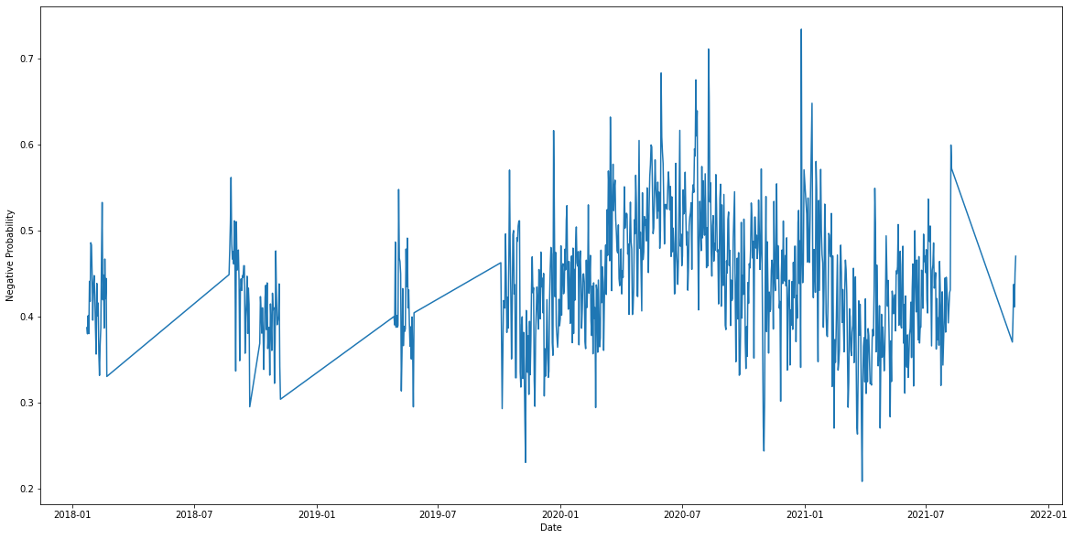
Sentiment over time analysis
Averaged the sentiment for each day for all 200k articles
Plotted the negative sentiment probability over date
Found no articles for most days in the year 2018 and 2019
High Negative sentiments in Q2 and Q3 2020, heavily due to Covid , people losing jobs and moving out.
More Positive Sentiments in late Q4 2020 , Q1 and Q2 2021 due to relaxed rules on mask , back to school.
Sentiment of news articles over time
Negative Sentiment vs Date

Slide 7
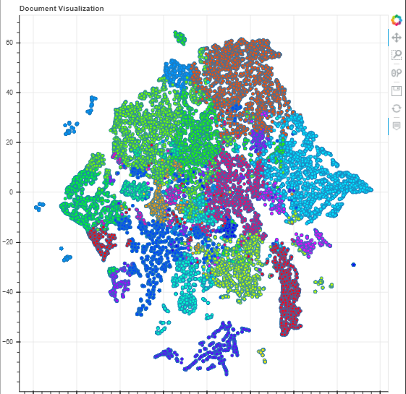
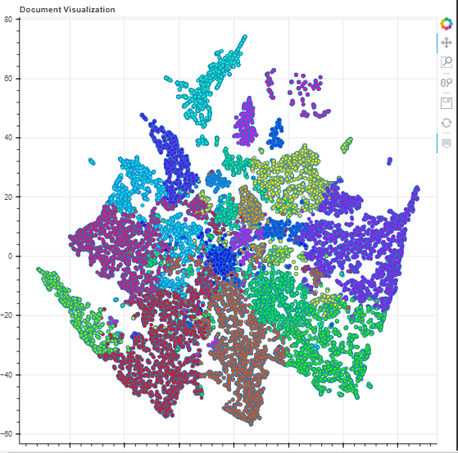
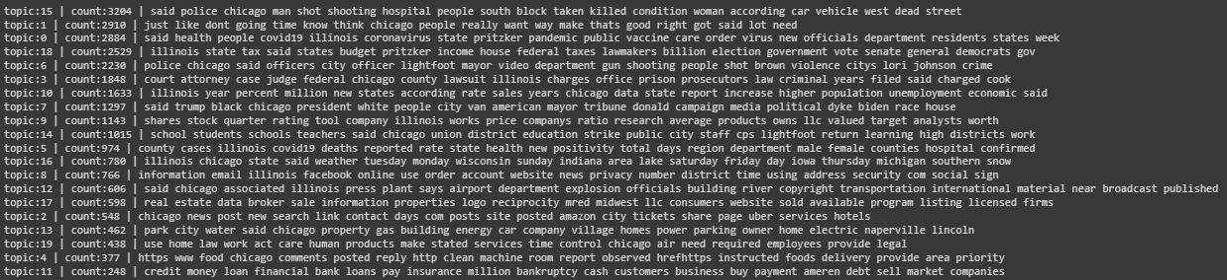
Target Sentiment Topic Modeling
Split the filtered articles based on sentiment.
Perform Topic modeling targeted to the sentiment using Ktrain with number of topics as 20
Identified and analyzed the keywords of each topic influencing the sentiment
Positive Articles Topic Cluster
Negative Articles Topic Cluster

Slide 8
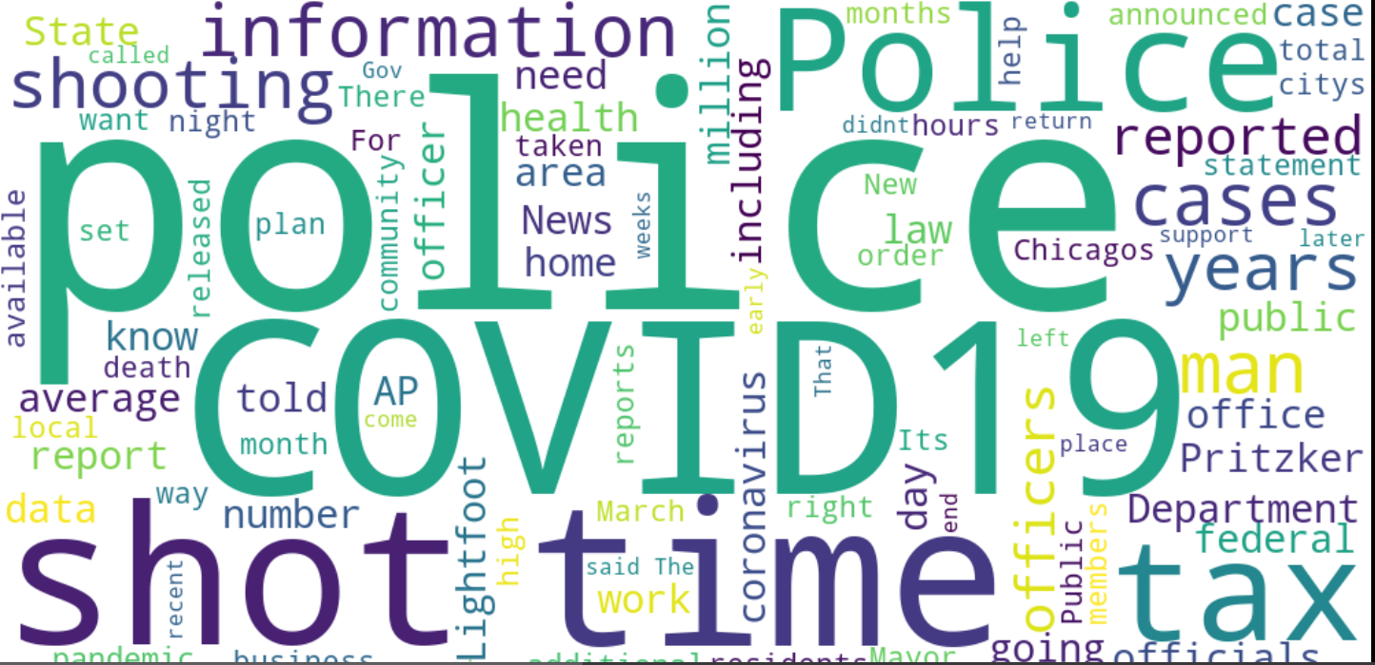
Negative Sentiment Articles- Topic Modeling
Performed Topic Modeling using KTrain for filtered articles by sentiment
Top Negative Sentiment Topics Influencing people and Organization Move out
topic:15 | count:3204 | said police chicago man shot shooting → Crime
topic:0 | count:2884 | said health people covid19 illinois coronavirus → Pandemic
topic:18 | count:2529 | illinois state tax budget pritzker income → State Tax
topic:16 | count:780 | illinois chicago state said weather → Weather
Top keywords that influenced negative sentiment

Slide 9
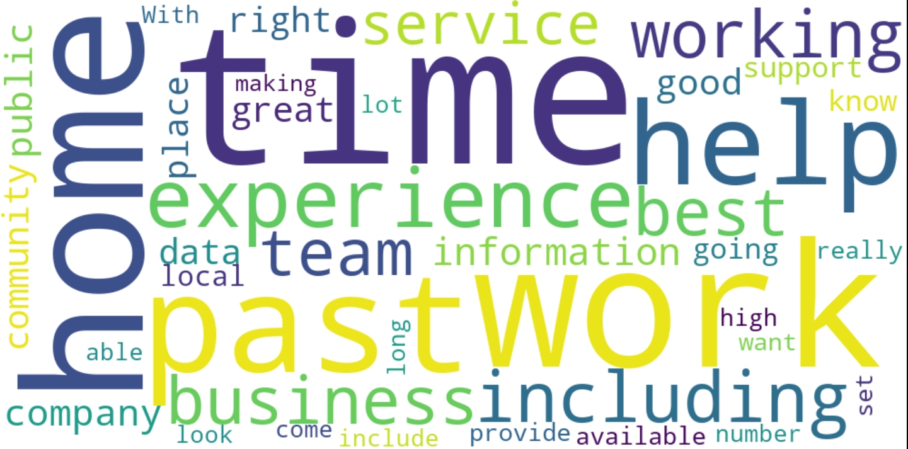
Positive Sentiment Articles- Topic Modeling
Performed Topic Modeling using KTrain for filtered articles by sentiment
Top Positive Sentiment Topics Influencing people and Organization stay or move in
topic:1 | count:3434 | illinois public county school states students → School
topic:10 | count:3165 | work business experience services job team → Business
topic:18 | count:2094 | chicago park city area water north lake → Entertainment/Fun
topic:6 | count:2037 | chicago new black city american history York → Diversity
Top keywords that influenced positive sentiment

Slide 10
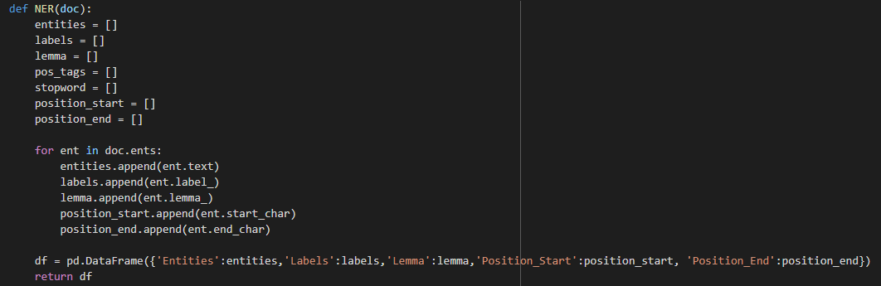
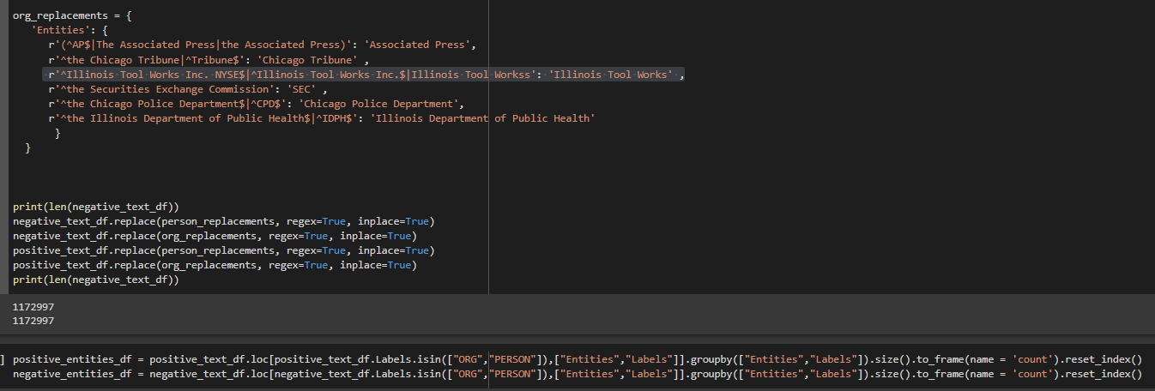
Entity Identification – Modeling and Steps
For Entity Identification , used NER from Spacy.
Ran NER on filtered data (relevant articles) by sentiment
Identified and assigned labels for each entity by sentiment
Applied regex to group similar entities (ex; r'^Illinois Tool Works Inc. NYSE$|^Illinois Tool Works Inc.$|Illinois Tool Workss': 'Illinois Tool Works’ )
Aggregated to find the total count of each entity to identify top entities by sentiment
Regex to group similar entity names(below)

Slide 11
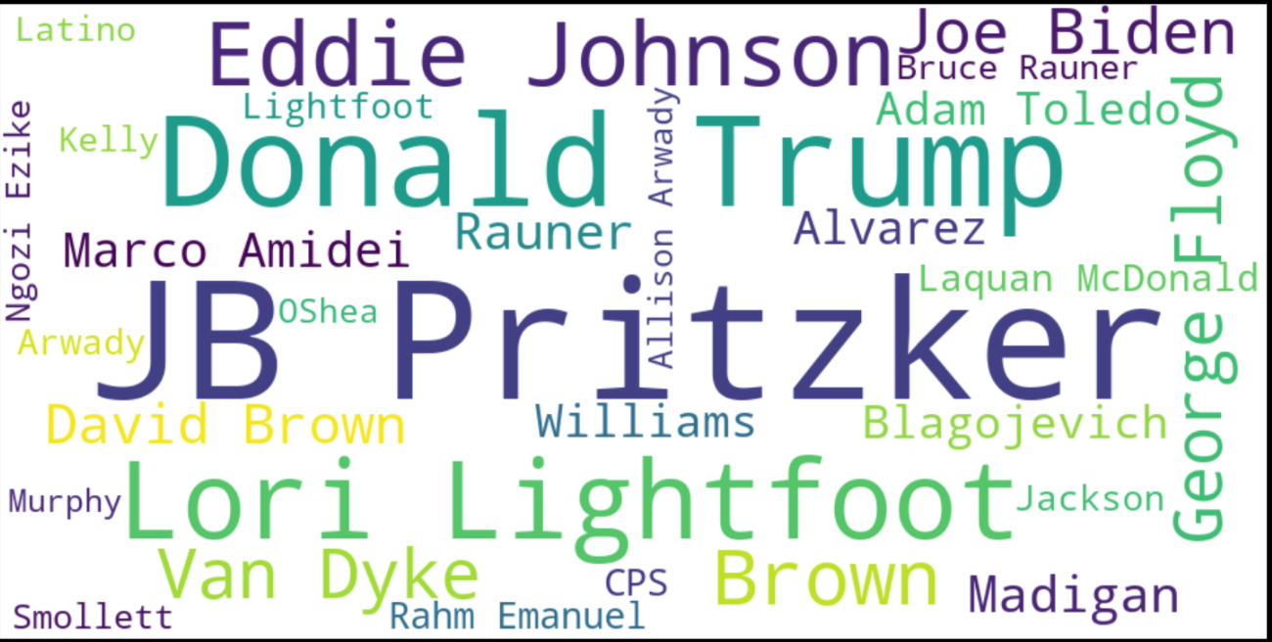
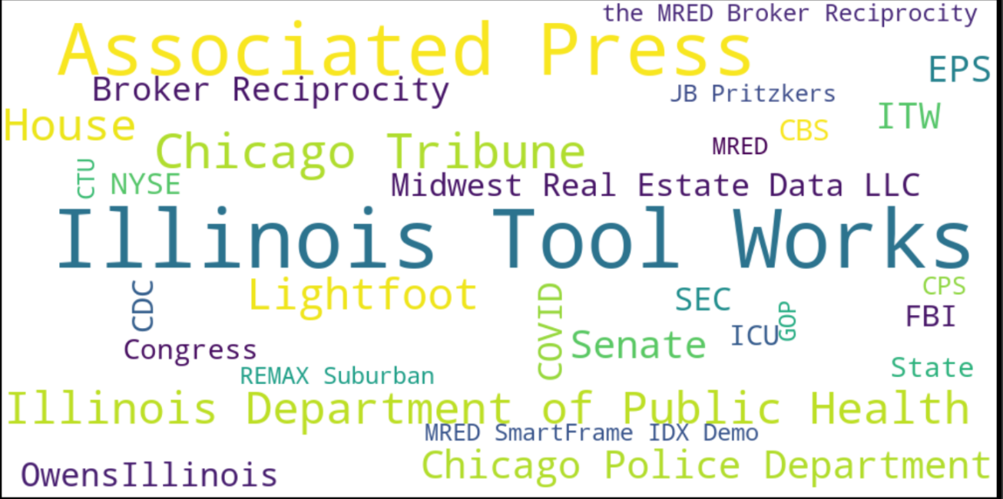
Entity Identification – Negative Sentiment
JB Pritzker, Donald Trump and Lori Lightfoot were mentioned the most in the negative sentiment related articles. Illinois Tool Works, Associated Process, Chicago Public Department are the organizations mentioned the most in negative articles
Top Peoples from the negative sentiment articles (Topmost : JB Pritzker)
Top Organizations from the negative sentiment articles (Topmost : Illinois Tool Works)

Slide 12
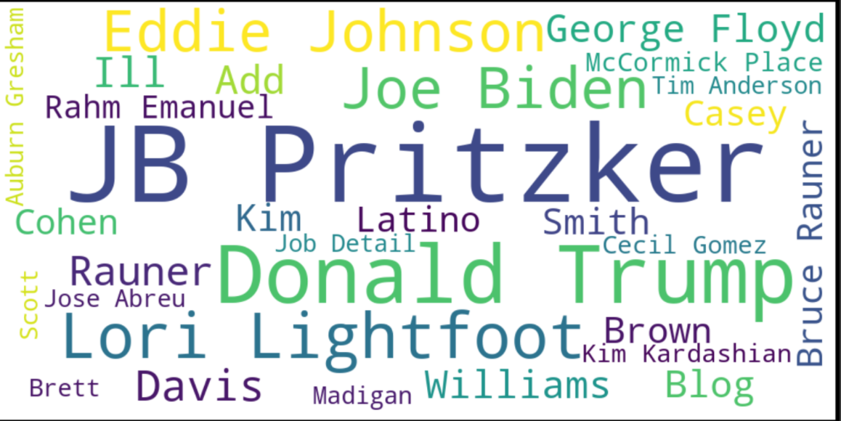
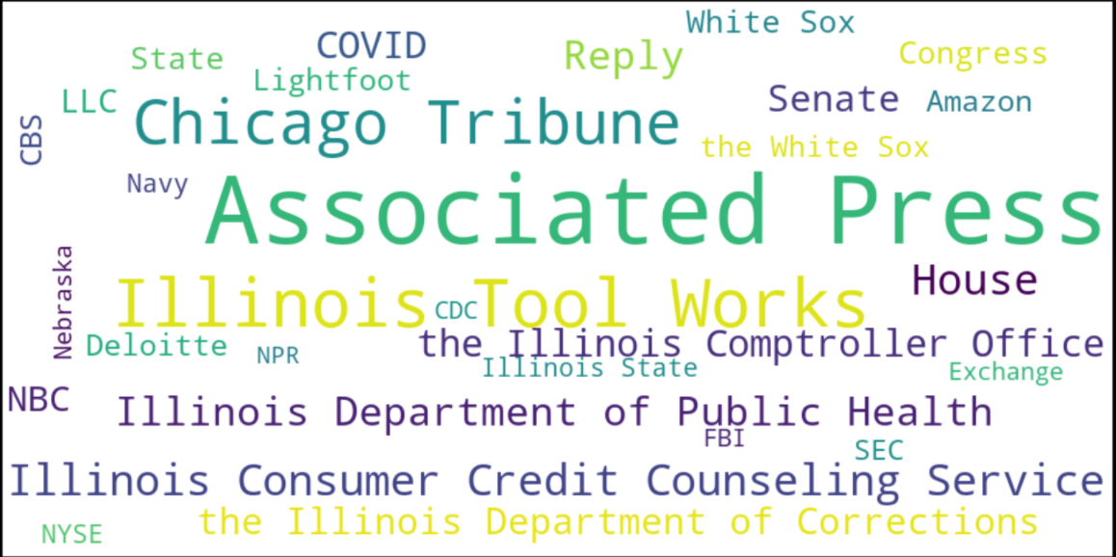
Entity Identification – Positive Sentiment
JB Pritzker, Donald Trump and Lori Lightfoot are also mentioned the most in the positive sentiment related articles. Associated Process, Illinois Tool Works, Chicago Tribune are the organizations mentioned the most in Positive articles
Top Peoples from the positive sentiment articles (Topmost : JB Pritzker)
Top Organizations from the positive sentiment articles (Topmost : Associated Press)

Slide 13
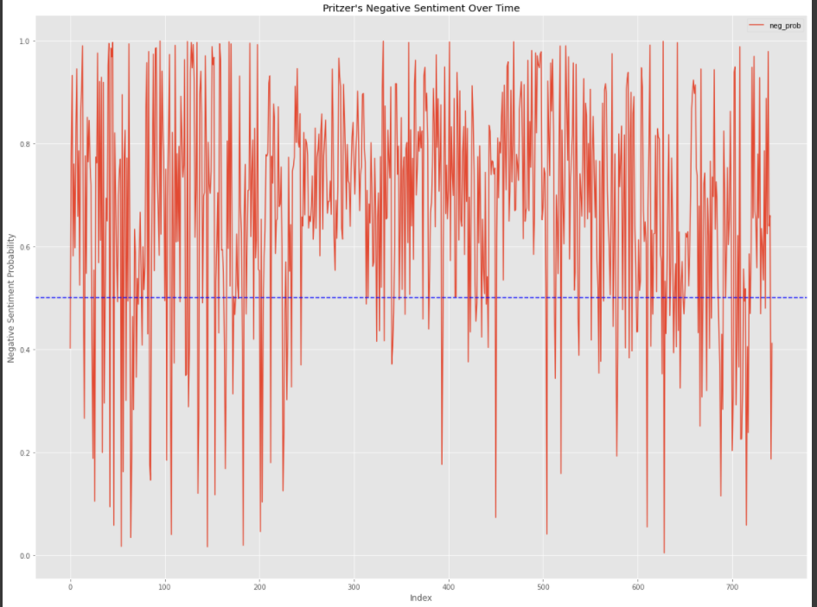
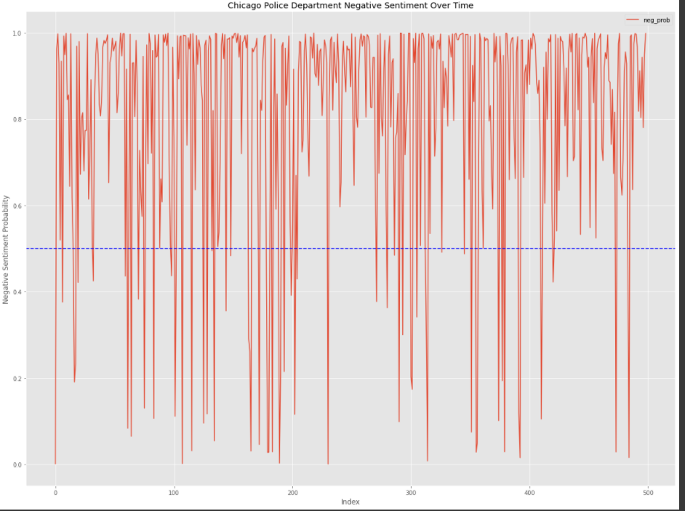
Targeted (entity) sentiment identification
Pritzker sentiments over time with more negative articles over covid restrictions
Chicago Police department with heavily skewed on the negative side

Slide 14
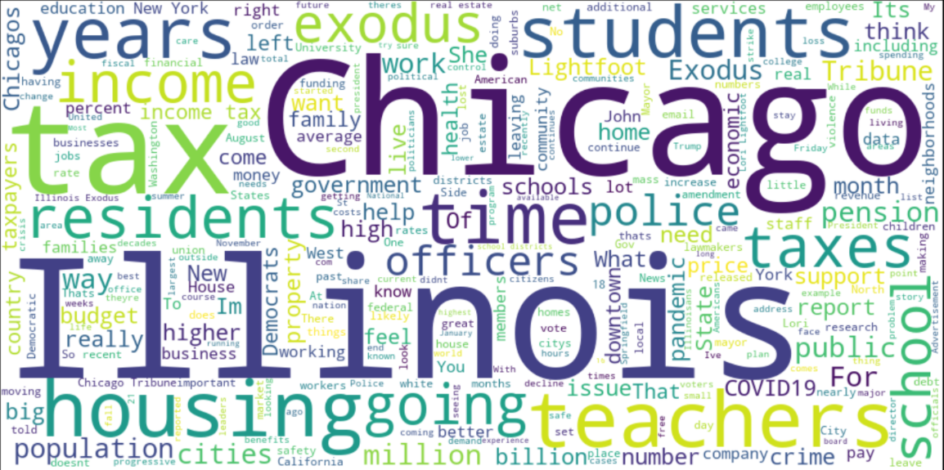
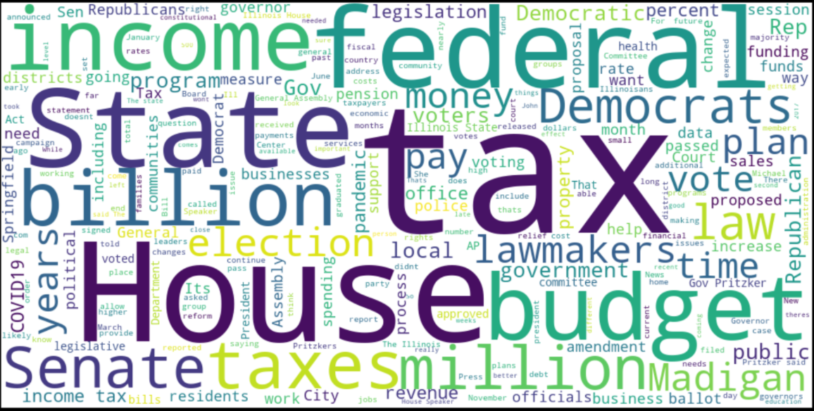
Actionable recommendations
Based on the research , recommend below actions to reverse the population trend.
Focusing more on creating a job friendly environment across the state
Focusing more on equity will lead to economy growth enhancing money making opportunities.
Arguably a stronger employment climate leads to less crime and poverty.
With the above 3, there will be more money flow to the state which can help in reducing tax burden to the residents and companies.
With the infrastructure and technological advancements, Chicago can become a hot spot .
Chicago must persuade businesses big and small to set root in job-starved neighborhoods on the South and West sides, where the loss of African-American population endangers the health and future of those communities.
Keywords from the articles related to exodus
Keywords from the topics related to income and tax

